Slide 1
ANALYTIC AVENUE
POWER BI PROJECT
TITLE
BUSINESS ANALYTIC DASHBOARD
BY PHEBE EVANGELINE R

Slide 2
PROBLEM STATEMENT
The objective of this project is to make use of data sets that include customer demographics, purchasing behavior, and marketing engagement. By analyzing customer segments, financial performance, and marketing campaign effectiveness, the aim is to improve strategic decision-making processes, develop better customer targeting strategies, and maximize revenue generation opportunities.
Customer Analysis : Understanding customer behavior is pivotal for strategic decision-making. Leveraging the provided dataset encompassing customer demographics, purchase patterns, and engagement metrics, the goal is to identify key segments, preferences, and trends. By analyzing factors such as age, income, presence of children, and customer type, the aim is to tailor marketing strategies, improve customer retention, and enhance overall satisfaction.
Finance Report :Efficient financial management requires comprehensive analysis of revenue streams, cost structures, and profitability drivers. Leveraging the dataset featuring sales transactions, product prices, and customer information, the objective is to generate insights into revenue trends, cost-effectiveness of different sales channels, and overall financial performance. This analysis will aid in optimizing pricing strategies, identifying areas for cost reduction, and maximizing profitability. Marketing Campaigns :Effective marketing campaigns rely on understanding customer preferences, campaign performance, and market dynamics. Utilizing the dataset containing information on campaigns, platforms, and customer demographics, the goal is to evaluate the effectiveness of past marketing initiatives. By analyzing factors such as campaign engagement, conversion rates, and customer response across different demographics and regions, the aim is to optimize future marketing strategies, allocate resources efficiently, and maximize return on investment.

Slide 3
APPROACH
DATA COLLECTING
DATA IMPORT
DATA CLEANING AND PREPROCESSING
SEGMENT ANALYSIS
CATEGORY ANALYSIS
FINANCE ANALYSIS
DYNAMIC DASHBOARD
STORYTELLING
REPORT
USER ENGAGEMENT
DATASET
https://docs.google.com/spreadsheets/d/1Y69r546REwrBKlLy8FM1B_EX7ok58VeT/edit#gid=158802934

Slide 4
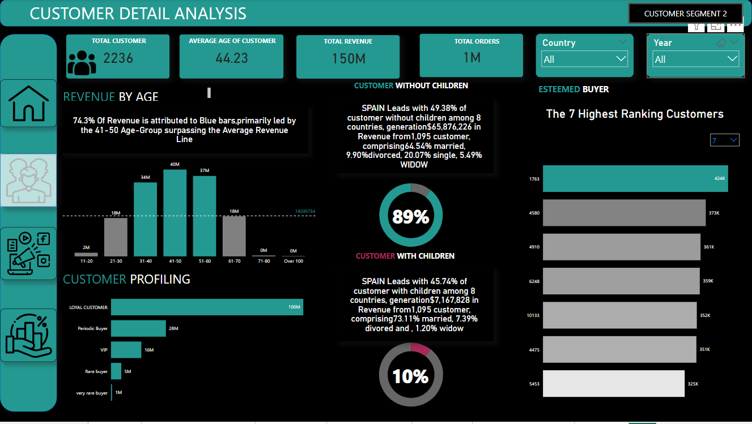
DASHBOARD
To view the interactive dashboard, please click on the following link
DASHBOARD :https://www.novypro.com/profile_projects/phebeevangeline

Slide 5
KEY INSIGHT
Understanding profitable customer segments and their characteristics.
Identifying growth opportunities within specific customer segments.
Tailoring marketing strategies and product offerings to meet diverse segment needs.
Evaluating campaign effectiveness in reaching target audiences.
Identifying successful marketing channels or platforms for customer engagement.
Assessing the impact of messaging or creative approaches on campaign effectiveness.
Analyzing revenue and profit trends to identify performance drivers.
Assessing cost structures and optimizing expenses.
Evaluating overall financial health and alignment with goals.
Identifying potential financial risks and opportunities.
Assessing the effectiveness of capital allocation and investment strategies.

Slide 6
TARGETED CLIENT
AMAZON
FLIPKART
MEESHO
ZEPTO
SPOTIFY
NETFLIX
HOTSTAR
NYKA
PURPLE
ZOMATO
UBER
RAPIDO
BIGBASKET

Slide 7
USE CASES IN REAL WORLD
Customer Segmentation and Targeted Marketing
Dynamic Pricing and Price Elasticity
Customer Lifetime Value and Retention
Campaign Performance Optimization
Product Development and Innovation
Cross-selling and Upselling Opportunities
Inventory Management and Supply Chain Optimization
Customer Service Optimization and Personalization
Market Research and Competitive Analysis

Slide 8
CONCLUSION
The Customer Segment Analysis report allows you to understand your audience better, identifying key segments based on demographics, behavior, and preferences. This insight enables you to tailor your marketing strategies to effectively target and engage each segment, ultimately driving higher conversion rates and customer satisfaction.
The Campaign Analysis report enables you to evaluate the performance of your marketing campaigns across various channels and initiatives. By tracking key metrics such as reach, engagement, and conversion rates, you can identify which campaigns are delivering the best results and allocate resources more efficiently to maximize ROI.
Finance Analysis report provides a clear overview of the financial implications of your marketing efforts. By analyzing metrics such as Profit & Loss statement for any customer / product / country or aggregation of the above over any time period and More.
Integrated dashboard equips you with the insights needed to drive strategic marketing decisions, enhance customer satisfaction, and maximize ultimately contributing to the overall success and growth of your business.

